Slide 1
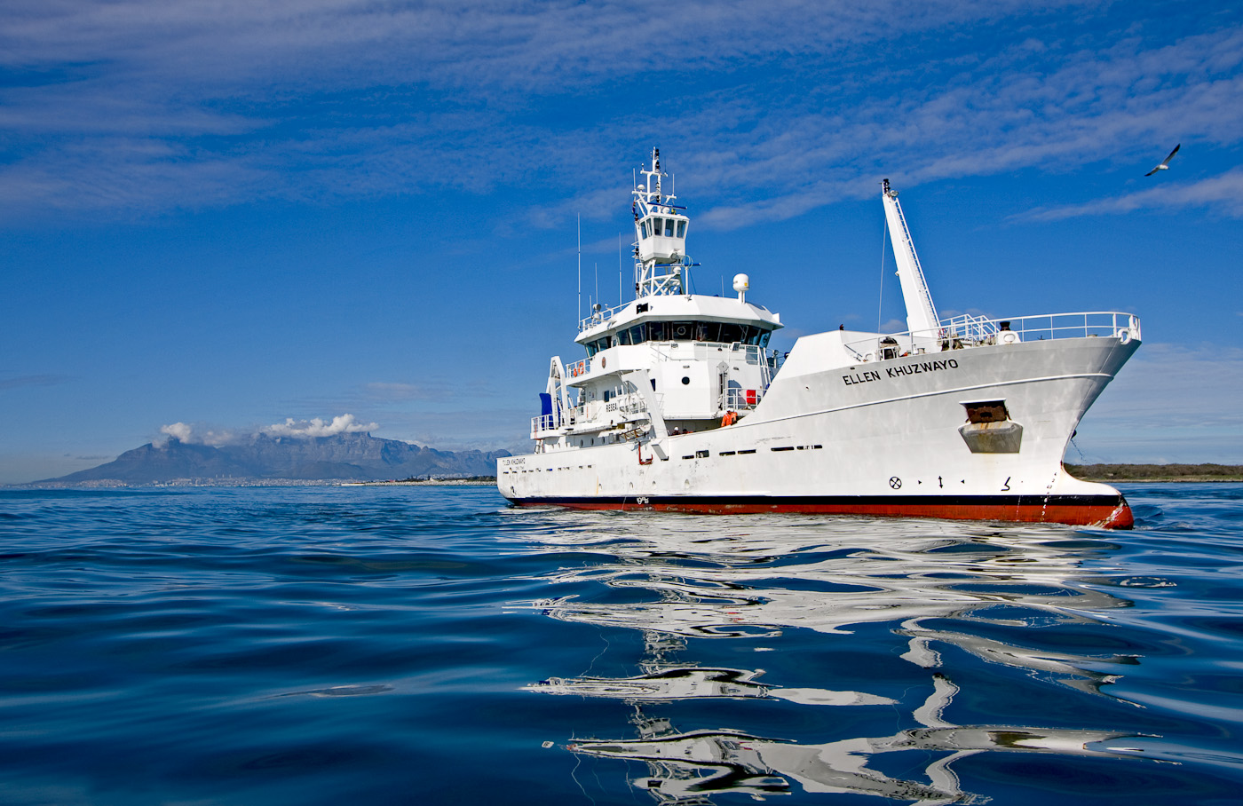
Inshore Resources Research
Research surveys:
Potential data sources for climate change research
Rob Tarr

Slide 2
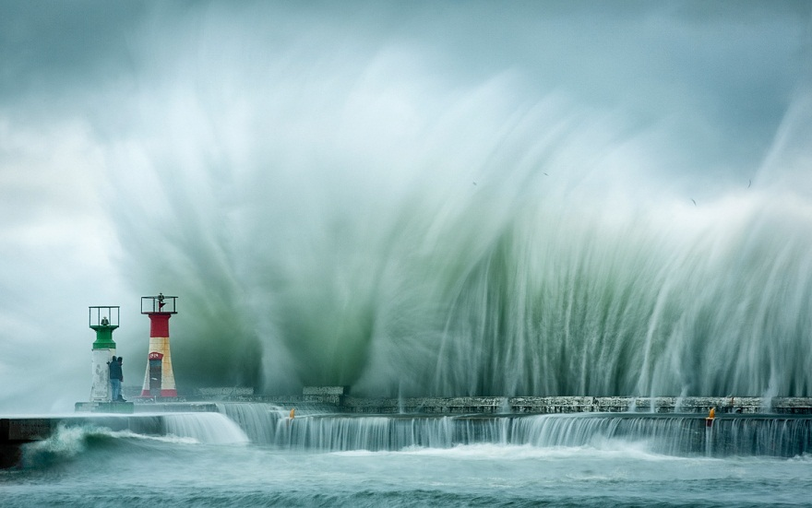
Inshore Resources Research
Research surveys:
Potential data sources for climate change research
Rob Tarr

Slide 3
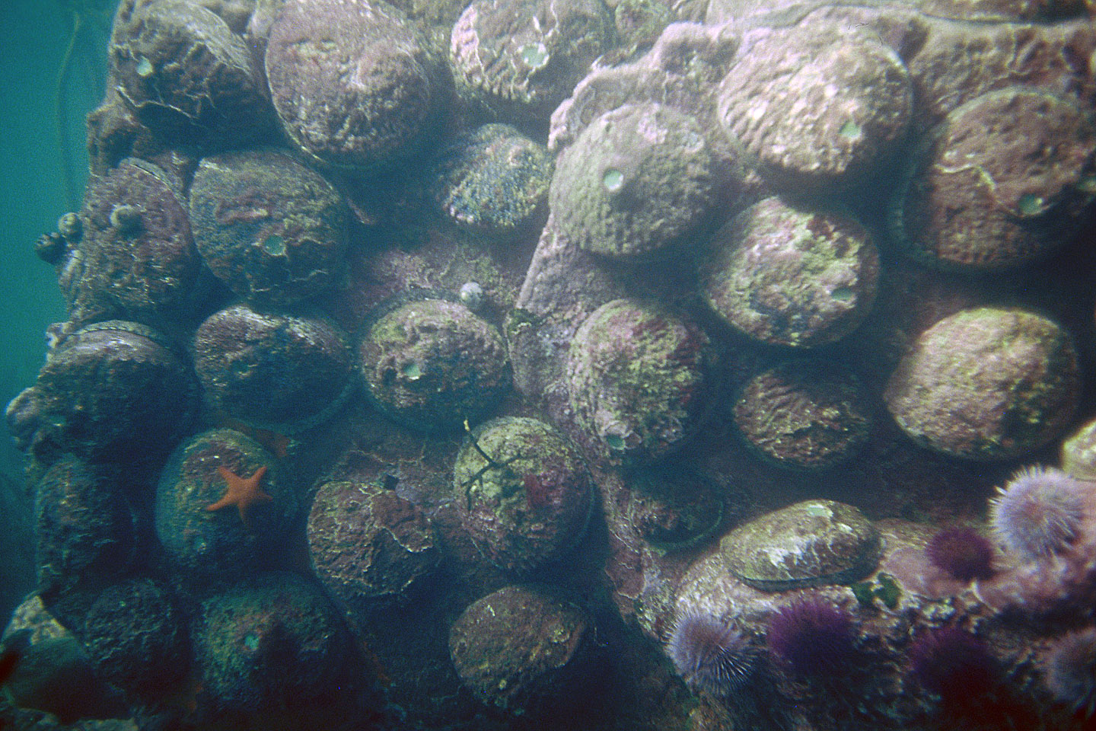
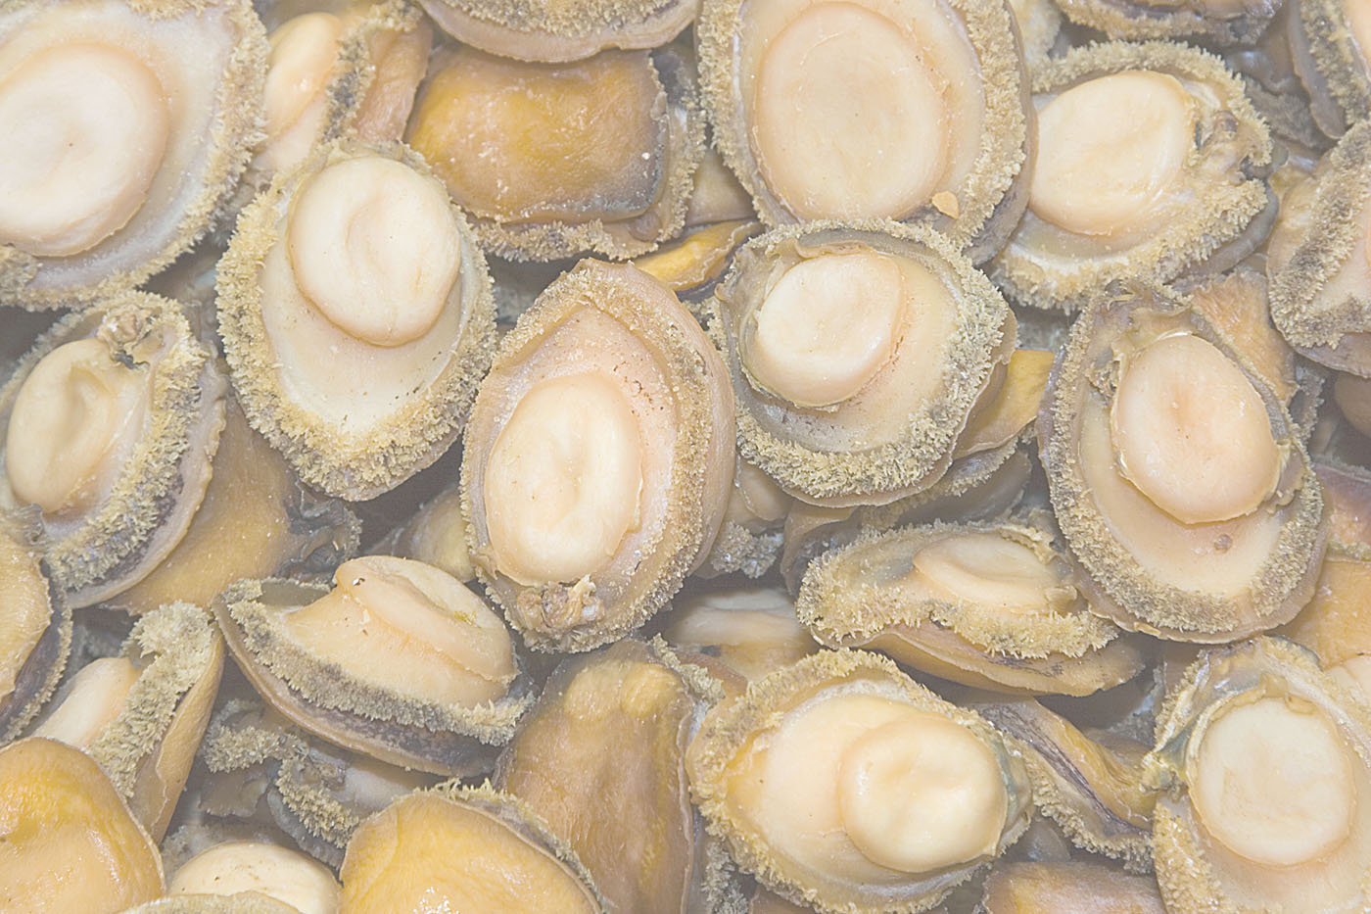
ABALONE SURVEYS
UPDATES OF WORK DONE IN THE LAST 4 MONTHS
ANNUAL TARGETS | PROGRESS ACHIEVED | CHALLENGES | CORRECTIVE ACTION
Research into relevant Inshore Resource species : Initiate, conduct and manage internal and external research, to improve understanding, and management, of Inshore Resources. | Abalone: Four extended recruitment surveys completed - required assistance from DEA or UCT divers All stations at Hawston and Sandbaai completed as well as at Romans Bay and Kruismansbaai. Numbers of juveniles were low. Completed all stations in Betties Bay - still no recruitment or urchins An additional 20 minute swim by 5 divers around the old tagging site produced only approx. 7 abalone seen Zone B (Gansbaai) - 4 commercial and gonad sampling trips completed. | Staff capacity constraints : vacant MRA post hampers dive surveys! Divers from other units not always readily available to assist abalone section at short notice; | Routinely need to request assistance from divers from other units in DAFF or DEA or outsource (hire) divers
SURVEY | AREA SURVEYED | TIME PERIOD | DESCRIPTION OF DATA
Fishery Independent Abalone Surveys: Aka FIAS | Quoin point to Cape Hangklip; Robben Island; 2 m to 15m depth | 1995 - present | 30 metre Dive transects - fixed GPS positions, repeated every year or 2 Record density and size composition of all abalone above 100mm shell length Record presence / absence / low-medium-high density of lobsters, urchins, juvenile abalone. Record dive conditions such as visibility & sea conditions. Target each year is 20 transects in each of 5 of the 7 fishing zones (exception Zone F - 16 transects). Poaching ….

Slide 4
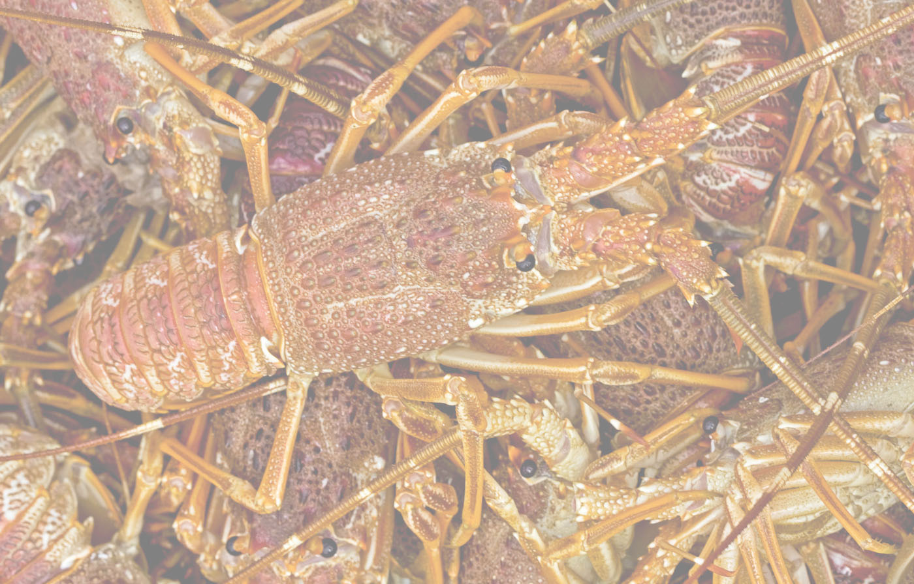
WEST COAST ROCK LOBSTER SURVEYS
SURVEY | AREA SURVEYED | TIME PERIOD | DESCRIPTION OF DATA
WCRL Fishery Independent Monitoring Surveys: Aka FIMS WCRL Migration study | Olifants river to Cape Hangklip Up to 200m depth Rocky bank area up to 220m depth | 1994 – present 2014 – present | Catch data from traps deployed in fixed GPS positions Repeated annually Approx 600 stations Numbers per trap, length frequency & sex ratio Weather and sea conditions recorded per station Monthly surveys south of Rocky bank Deep station lobsters tagged for migration studies At each of 5 stations CTD and biological data collected

Slide 5
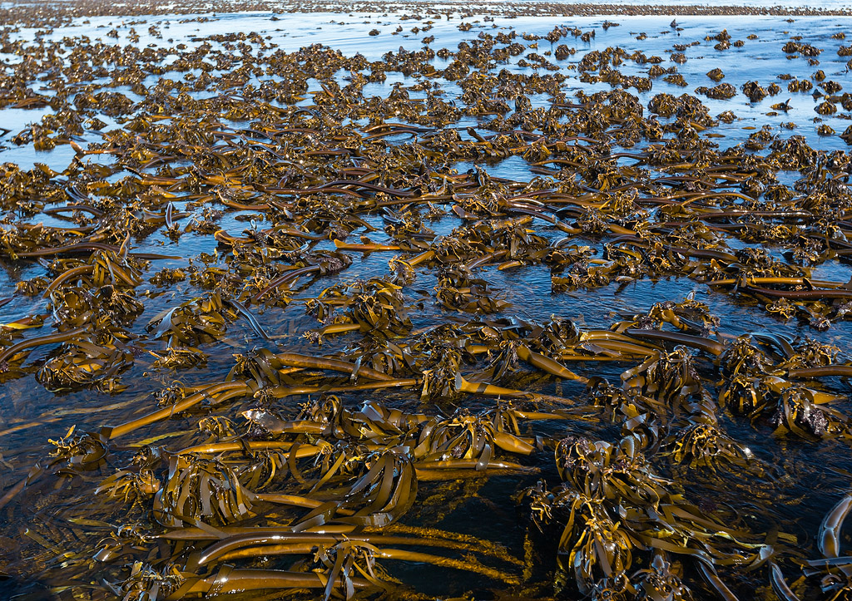
KELP & SEAWEED SURVEYS
SURVEY | AREA SURVEYED | TIME PERIOD | DESCRIPTION OF DATA
Kelp (general) Seaweed / kelp Seaweed Gelidium pristoides Seaweed – general collections | West Coast from Orange river to Agulhas Port Nolloth, Kleinzee, Hondeklip bay, Doringbaai, Jacobs bay, Gansbaai Cape St Francis & Port Alfred Entire SA coast | Single surveys from 1996 - 2001 2008 to present; annually or biennially 2011 (CSF) and 2009 (PA) to present 1985 – present | GIS maps of kelp beds from aerial IR & other aerial & satellite data Fixed sites. Long transects with surface quadrats recording # kelp heads/ area / depth zone Some biomass data Long term monitoring sites Data from quadrats Biomass & % cover Comprehensive spreadsheet of distributions for >500 species Long-term indicator of temperature changes in inshore zone

Slide 6
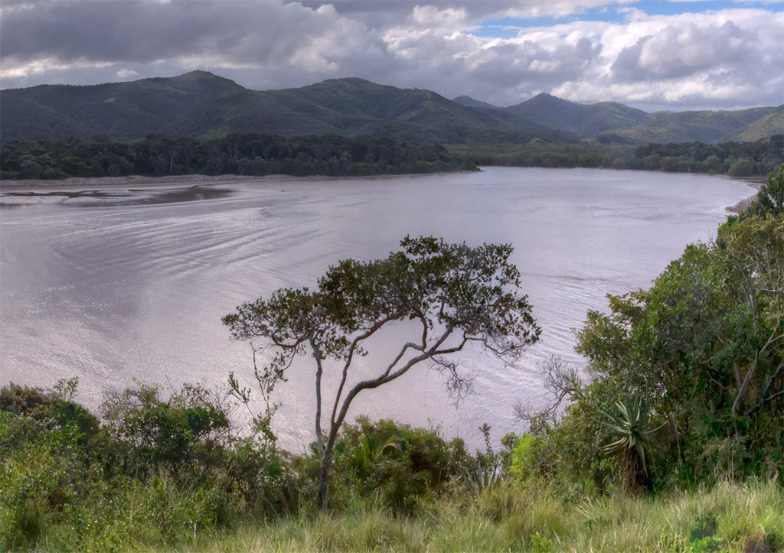
ESTUARINE FISH RECRUITMENT SURVEYS
SURVEY | AREA SURVEYED | TIME PERIOD | DESCRIPTION OF DATA
Estuarine Fish Recruit-ment | From Orange river to East Coast (Mbashe R) | 2003 to present 14 bigger systems (eg Breede) Expanded from 2008 to include smaller systems (eg Klein Brak) | Once annually to quarterly fish surveys Standardised small-mesh seine and gillnet sampling Collection of environmental data (temperature, salinity, dissolved oxygen, pH, turbidity) Data loggers, temperature & salinity deployed in about half of these systems Freshwater flow time series data obtained in collaboration with CSIR, DWS et al. The Mbashe to Kei and Gouritz to Heuningnes systems are surveyed intensively (collaborative project) Changes in fish assemblages (& invertebrates, micro, macrophytes, hydrodynamics, sediment transport etc) Overarching themes of the long-term monitoring are altered freshwater flows and the freshwater requirements of marine and estuarine fish and fisheries.

Slide 7
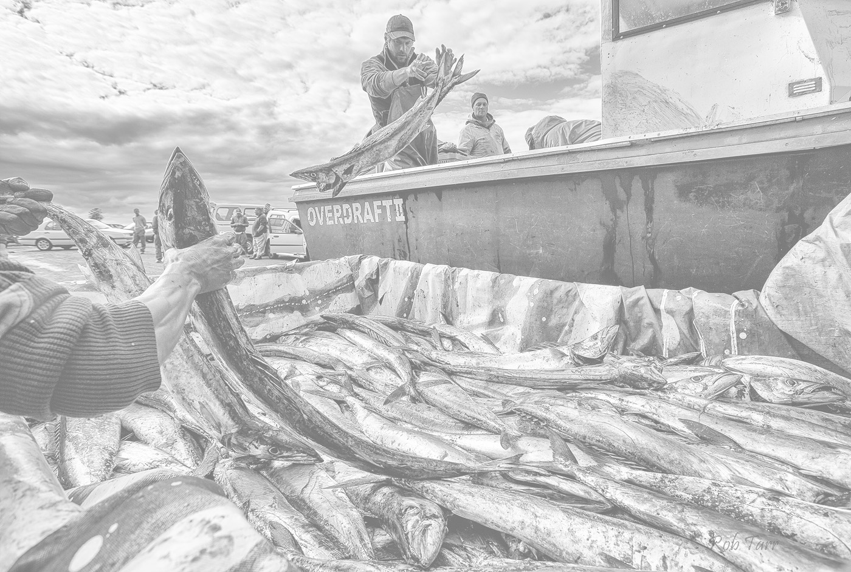
LINEFISH DATA
SURVEY | AREA SURVEYED | TIME PERIOD | DESCRIPTION OF DATA
Data from National Marine Linefish System | Entire South African coastline | 1984 to present | NMLS contains commercial linefishery catch return data These data are spatially referenced and contain catch per boat per species per daily outing. Operating small craft is dependent on weather conditions. Anecdotal evidence from fishers indicate that the number of sea days are diminishing due to an increase in wind strength This was confirmed for the Arniston artisanal linefishery where wind strength was a significant predictor for boat outings per day. Under standard conditions this can result in up to 20% difference in outings between low and high wind years. With the easterly wind strength projected to increase, small nearshore fisheries will experience a decrease in fishing opportunity. Similar data have been collated for the nearshore west coast lobster fishery, the False Bay recreational fishery, and the small vessels of the sardine purse seine fishery. A similar, more comprehensive analysis is underway. Augustyn J, Cockcroft A, Kerwath S, Lamberth SJ, Githaiga-Mwicigi J, Pitcher G, Roberts M, van der Lingen C. 2016. Chapter 15 South Africa In Climate Change and Fisheries, in press. ​

Slide 8
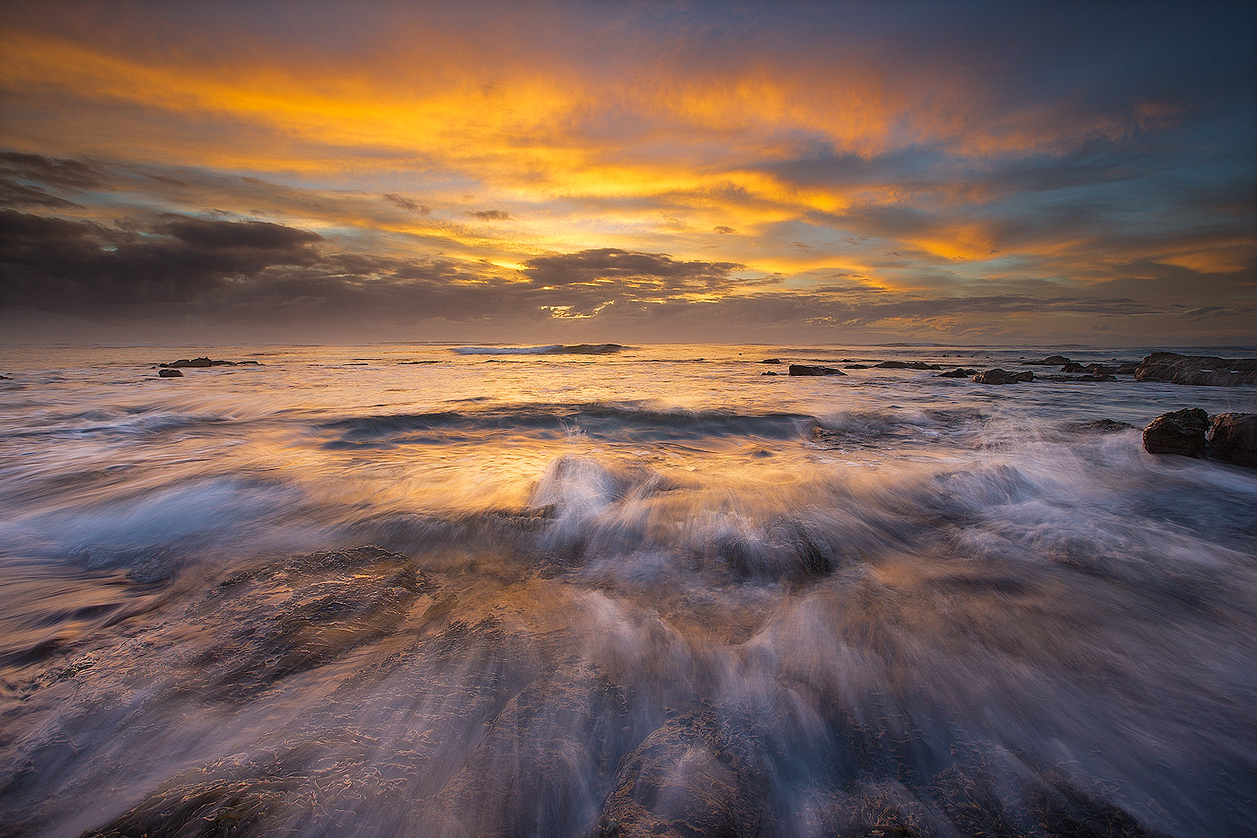
Thank you

